Slide 1




WELLNEST.AI
B.Tech CSE AI ML
SEM - V

Slide 2

Table Of Content
Introduction
Project Objectives
WebApp OverView
Key Predictive Models
Future Enhancements

Slide 3

Introduction
WellNest.ai
"WellNest.ai" represents a pioneering leap in the realm of health and wellness. This visionary project fuses the power of artificial intelligence and machine learning to empower individuals to take charge of their well-being. With a focus on three vital aspects—diabetes risk assessment, heart disease prediction, and personalized calorie expenditure estimation—our platform equips users with actionable insights. By leveraging predictive models and a user-friendly Flask-based web application, "WellNest.ai" redefines health management, offering early warnings and personalized recommendations.

Slide 4

Project Objective
The problem at hand is the lack of accessible and personalized tools for individuals to proactively manage their health and wellness.
Many individuals face challenges in assessing health risks such as diabetes and heart disease, and in estimating calorie expenditure during exercise. "WellNest.ai" addresses these issues by developing predictive models and a user-friendly platform that provide personalized insights and recommendations, empowering users to make informed decisions about their well-being.

Slide 5







WorkFlow
Analysis and Elicitation
Model Building
Live Deployment
Data Sourcing
And Cleaning
Model Integration
with framework

Slide 6

WebApp Overview
ABOUT
Our web app, built on Flask, offers an inviting and secure user interface. Users can effortlessly input their data, receive personalized health insights, and interact with predictions in real-time. The simplicity and flexibility of Flask serve as the framework, ensuring a seamless and interactive experience for accessing valuable health and wellness insights.

Slide 7
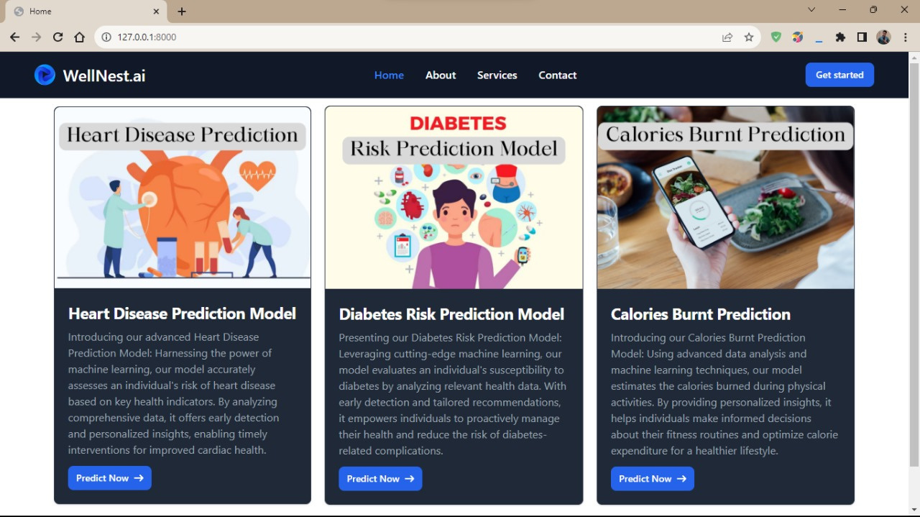
User Interface

Slide 8
Predictive Models
Diabetes Prediction Model
This model is designed to assess an individual's risk of developing diabetes.
By inputting key health parameters, users receive personalized predictions and early warnings, empowering them to make informed lifestyle choices and monitor their health proactively.
Logistic Regression has been used to achieve an accuracy score of 80%

Slide 9
Predictive Models
Heart Disease Prediction
Our heart disease prediction model provides users with insights into their heart health.
It acts as a virtual health advisor, guiding users in maintaining a healthy heart and making proactive health decisions.
Logistic Regression has been used to achieve an accuracy score of 85.25%

Slide 10
Predictive Models
Calories Burnt Prediction Model
For fitness enthusiasts and those aiming to maintain a healthy lifestyle, the Calories Burnt Prediction model is a valuable tool.
It estimates the calorie expenditure during physical activities, helping users plan their workouts and diet effectively.
It uses Linear Regression to achieve an accuracy score of 96%.

Slide 11
Future Enhancements
Improvement in accuracy score using much bigger dataset
Implement user profiles that allow users to save their health and fitness data, track their progress over time, and receive historical insights.
Add a section with articles, tips, and resources related to health, fitness, and well-being to educate and engage users

Slide 12





Meet
Our Team
Abhijit Mandal
Sumit Kumar
Divyanshi

